Slide 1
iPads and Technology in PE “Working smarter, not harder!”
Brian Devore
Physical Education Teacher
Mountain View Elementary School
Georgia AHPERD President
briangahperd@comcast.net
770/402-1114

Slide 2
Considerations to adding technology in Physical Education:
Can I connect?
What is my county/building/administrative philosophy?
Teacher or student use?
Administrative, classroom tasks, or classroom management?
Device?

Slide 3
iPads
Great tool for PE teachers due to portability
Variety of “apps” to perform different tasks
Can connect to LCD with connector cord
With correct case, virtually indestructible
BUT………

Slide 4
The “Downside”
Apps cost money
Money can be spent on apps that may not be appropriate
Connection issues can ruin a lesson

Slide 5
Apps that I have found helpful……

Slide 6
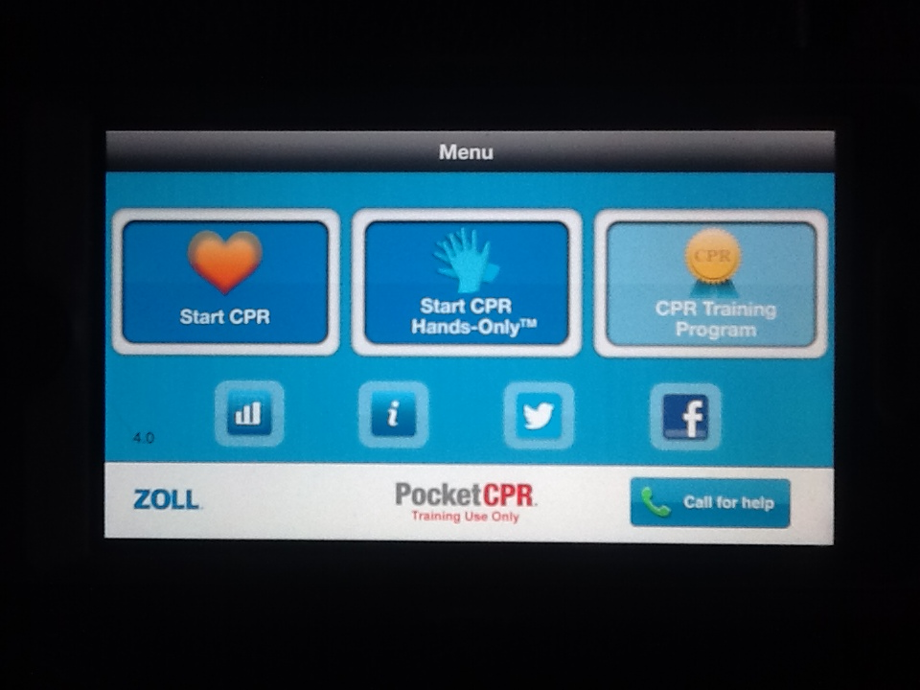
Pocket CPR
Pocket CPR can lead you through a training session on CPR or direct you through an actual CPR emergency!

Slide 7
Pocket CPR
You will be given the directions for CPR. In addition, holding your device will measure the depth of your chest compressions to make sure they are correct!

Slide 8
Cloud Storage “Dropbox”
Dropbox enables you to store any data in the “cloud”. Thus, you can access it at any time through a variety of devices, such as smart phones, tablets, or computers. Also, you can share folders of information within a group of other Dropbox users.

Slide 9
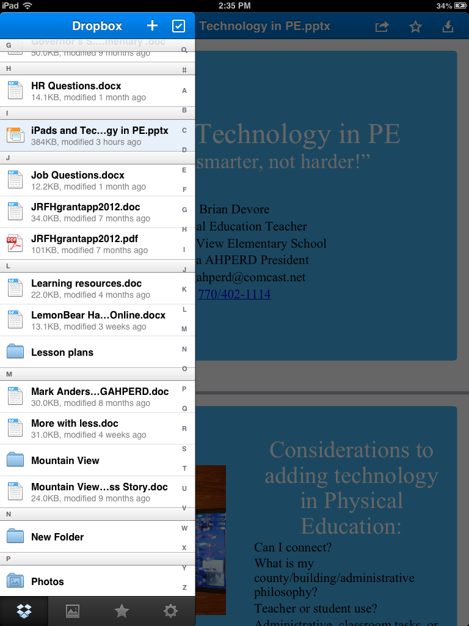
Dropbox (phone/tablet)
You can access any documents via a wireless connection. Also, marking files as favorites will enable you to view them without a connection.

Slide 10
Dropbox via computer
You can get a Dropbox account on the web. Also, you can create “shared” folders on the web version that will let you share documents with other Dropbox account holders.

Slide 11
Music Workout
Music Workout is an app that will set a time of “work” and a time of “rest”. You can adapt each workout and store them for future use.

Slide 12
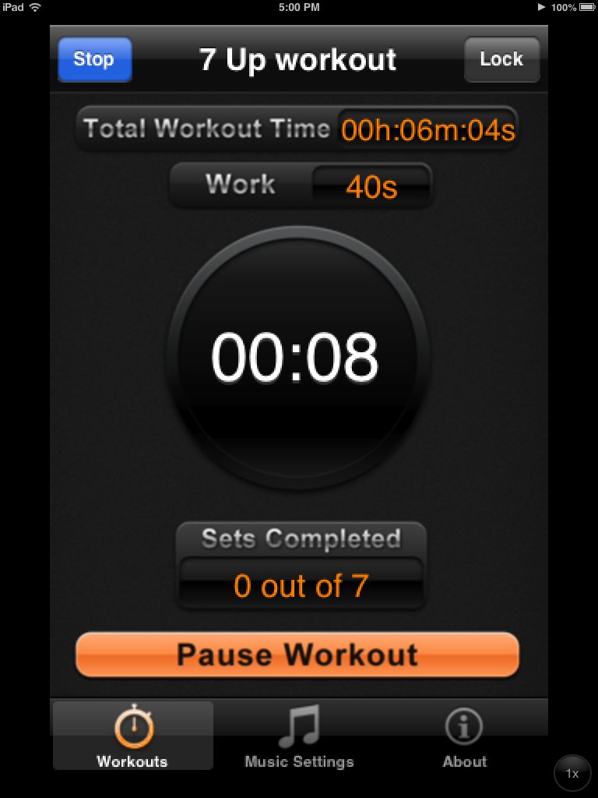
You can use music from your device (phone or tablet).

Slide 13
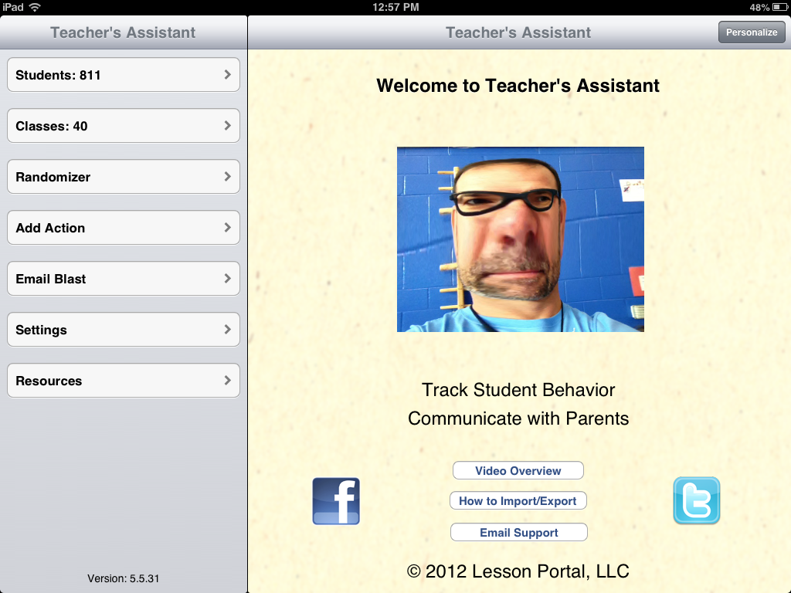
Teacher’s Assistant Pro
This app will enable you to track behavior, grading, communication, health issues and any other data on your students. Depending on your how student data is tracked at your school level, you may be able to import students/classes without having to type in all the information.

Slide 14
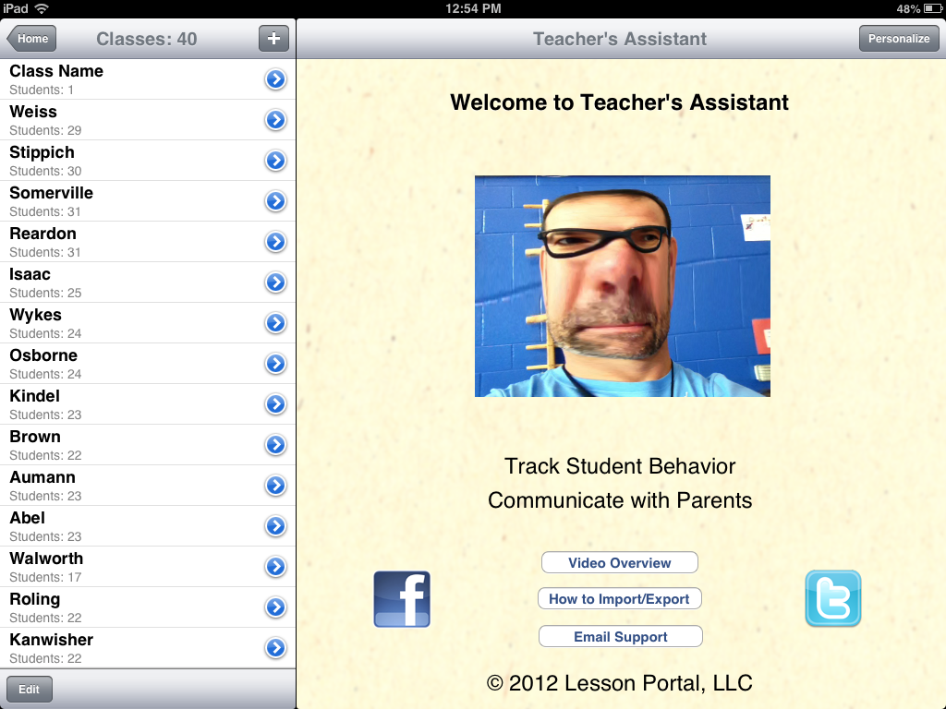
Student info can be tracked by class or searching the entire data base.

Slide 15
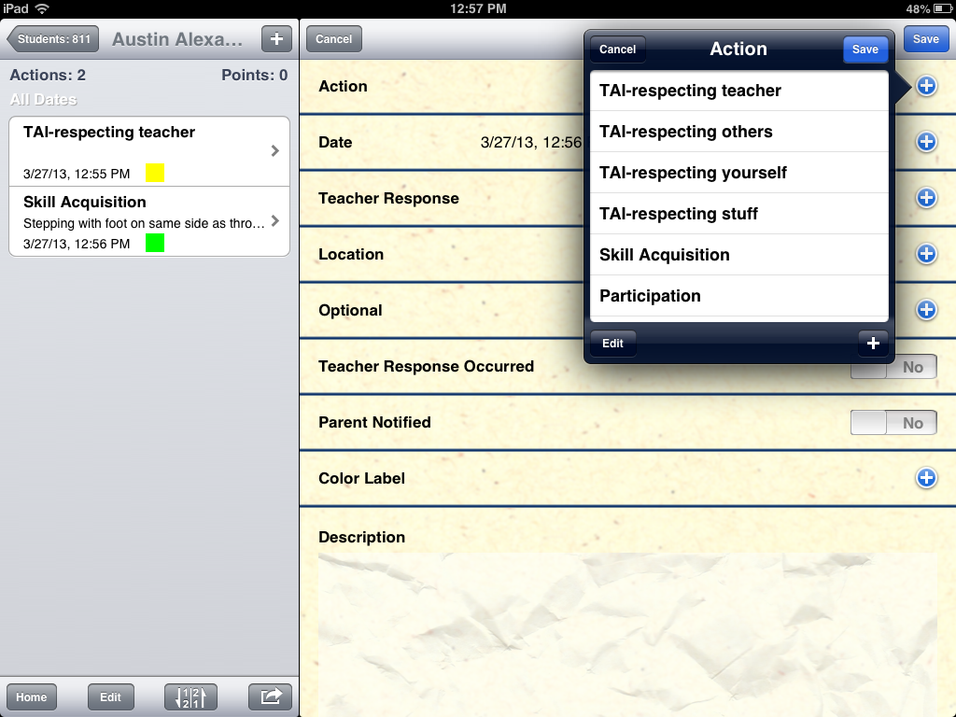
Student data page
This is a sample of a student page. Pull down menus allow you to set up touch screen menus of your choice.

Slide 16
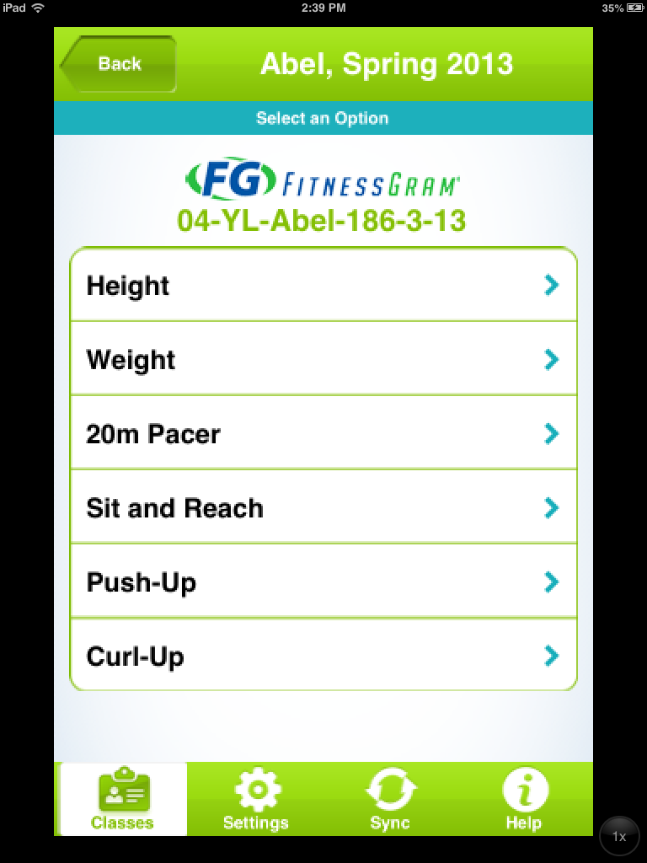
Fitnessgram
This app can be utilized with iPads or iPhones to enter in the data with a touch screen. A sync can transfer scores to an online system, if you have one.

Slide 17
MultiStop
Creates up to 6 stopwatches to be used at once. Results can be emailed or saved.

Slide 18
LCD/Smartboard apps
There are multiple apps that allow you to use a tablet connected to an LCD to project images that can be drawn on or have a portable “chalkboard”. Some will allow you to store data, images, and drawings in the “cloud”.

Slide 19
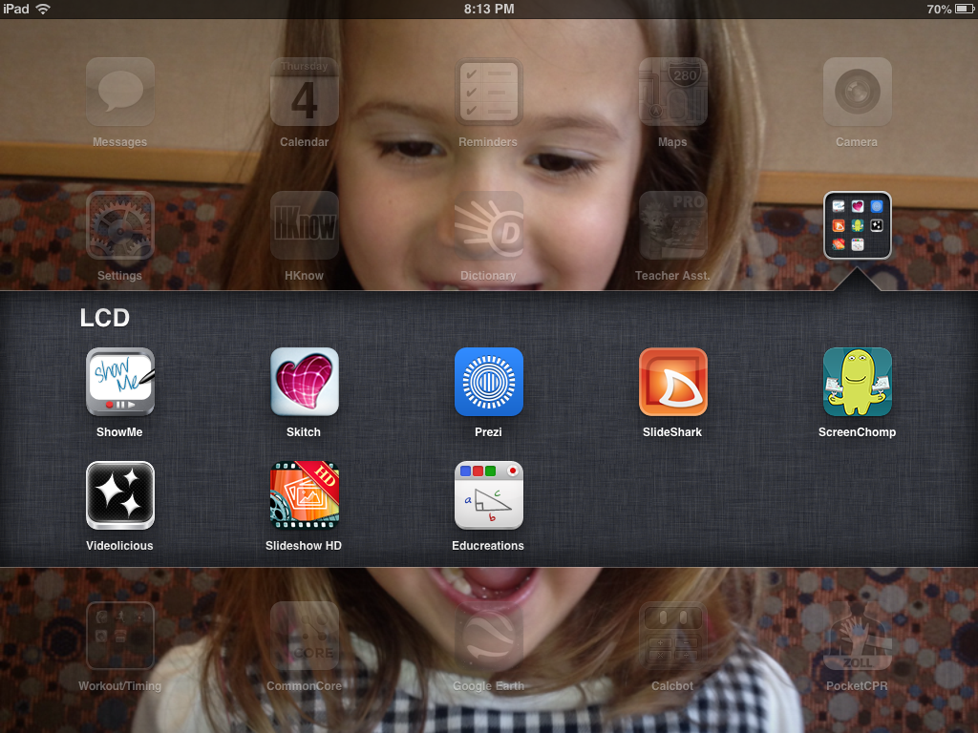

Slide 20
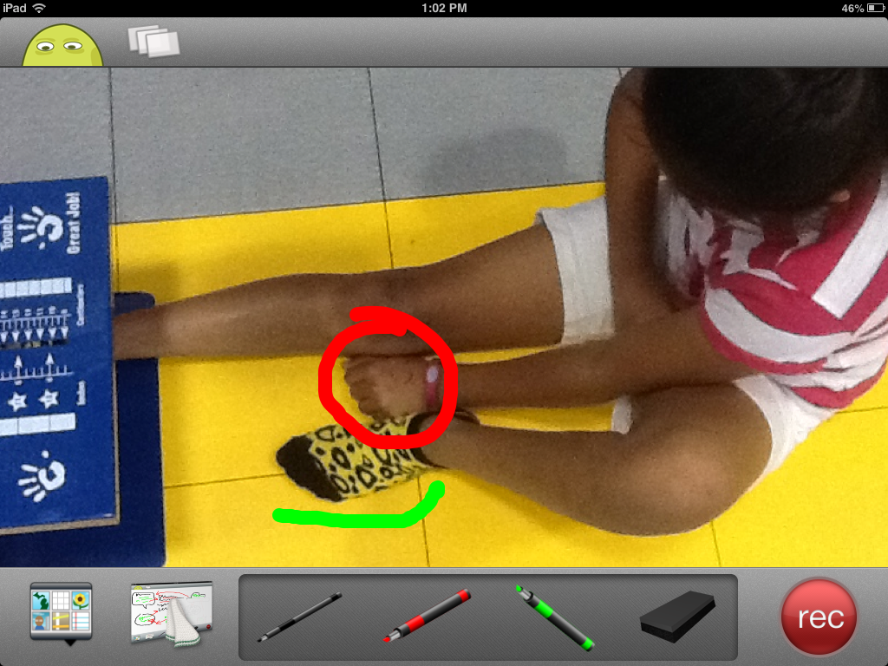
This image was created with Screenchomp to assist in teaching our younger students about the sit and reach test.

Slide 21
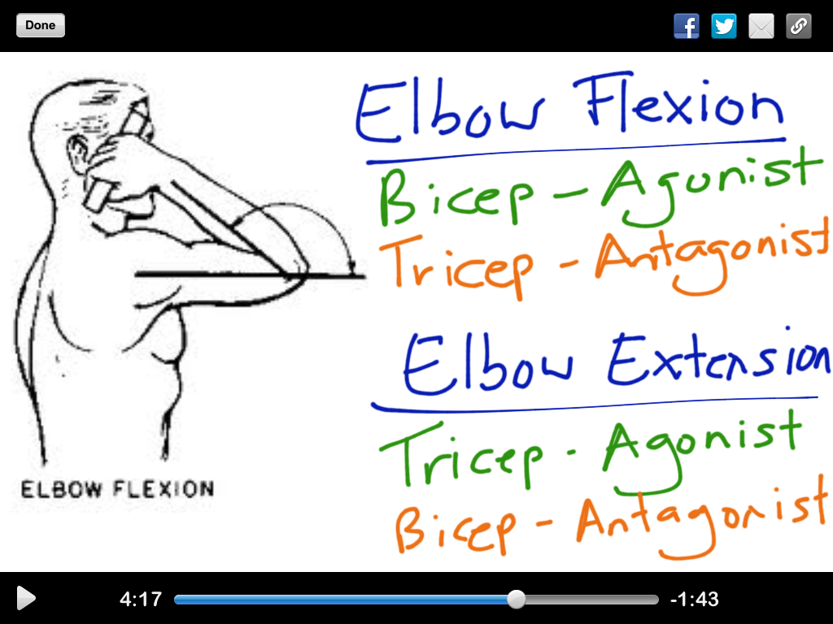
Educreations will let you browse and use presentations created and shared by other teachers.

Slide 22
Slideshark
If you save a Powerpoint to the “cloud”, you can import it into your iPad via Slideshark to show through an LCD.

Slide 23
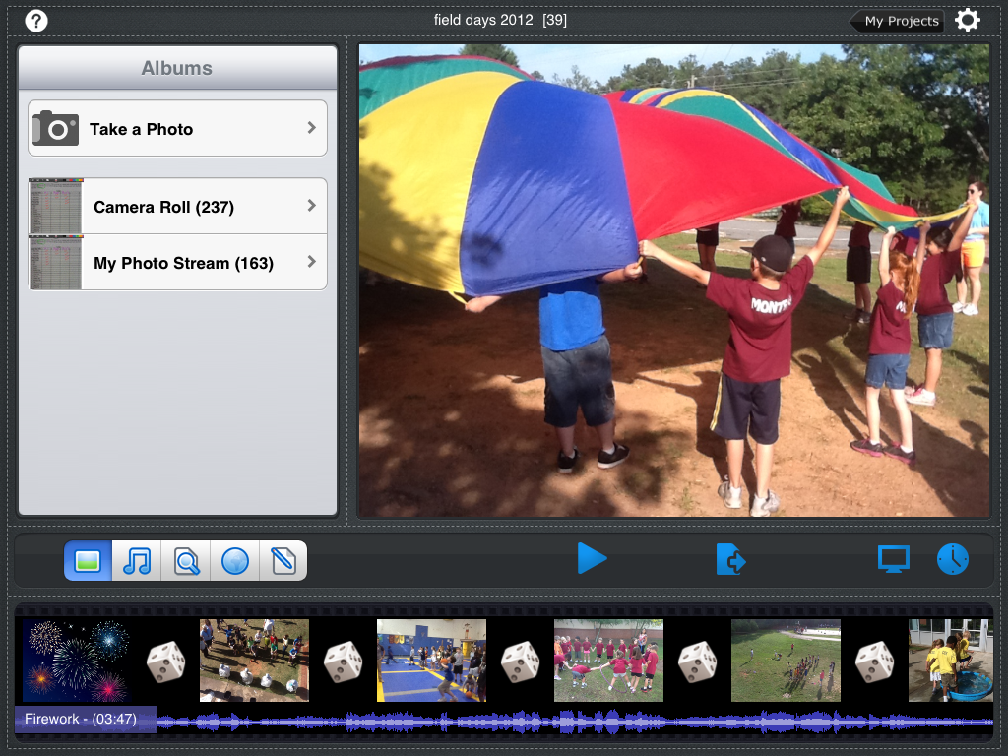
Slideshow HD You can create your own slideshows with pictures and music from your tablet.

Slide 24
In closing, there are multiple ways to integrate technology, particularly iPads, into a K-12 Physical Education setting. You will make some mistakes when you get started, but don’t let that deter you! Remember....

Slide 25
YOU CAN DO IT!

Slide 26
Any questions?
Brian Devore
Physical Education Teacher
Mountain View Elementary School
Georgia AHPERD President
briangahperd@comcast.net
770/402-1114
Twitter @bdevore7
LinkedIn Brian Devore
www.coachdpehub.weebly.com

